Slide 1
Computer Vision and Deep Learning
Lecture 6

Slide 2
Transfer learning

Slide 3

Transfer learning

Slide 4
Transfer learning
Have some dataset for a problem you want to solve but it has < ~1M images?
Find a very large dataset that has similar data, train a big ConvNet there
Transfer learn to your dataset
It’s the norm, not the exception!

Slide 5
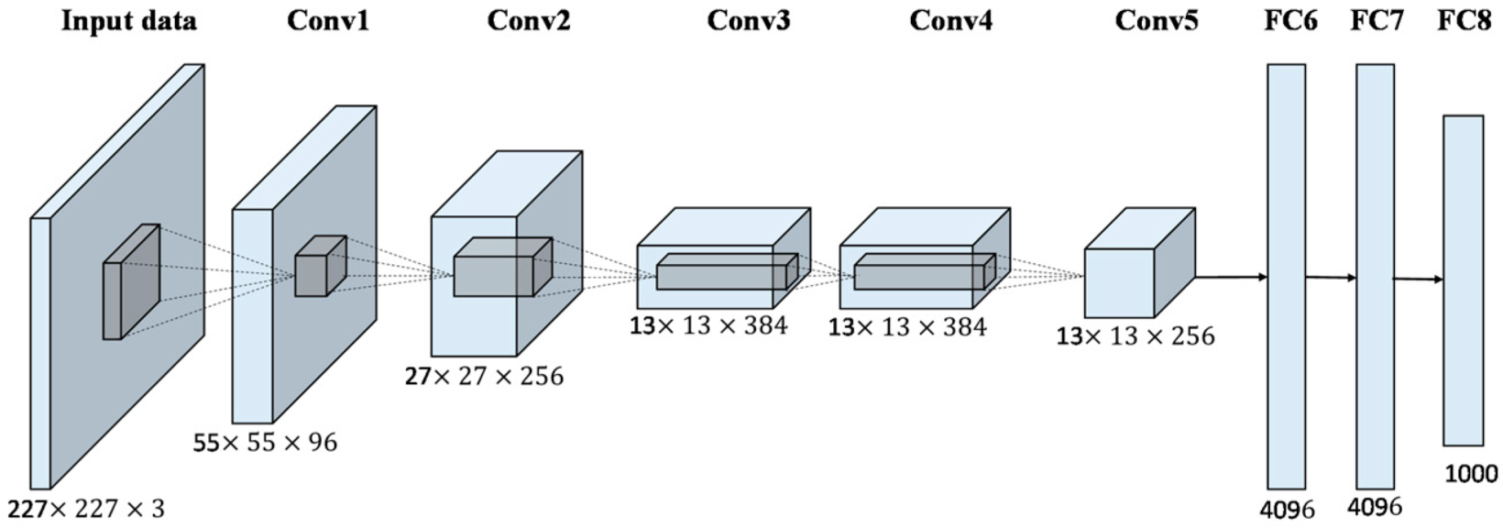
Transfer learning – small database
Train on a similar large dataset: ImageNet, COCO etc.
“freeze” these layers
Change the last dense layer to C classes, reinitialize and train it

Slide 6
Transfer learning – larger database
Train on a similar large dataset: ImageNet, COCO etc.
“freeze” these layers
Train these layers
Use a lower learning rate when finetuning! 1/10 of the original learning rate is a good starting point

Slide 7
Transfer learning
More generic features
More specific features

Slide 8
Transfer learning
 | Similar large dataset | Different large dataset
Few training data | Change and train the last layer | 🥺 linear classifier from different layers in the net ?
Quite a lot of training data | Fine-tune a few layers | Fine-tune a larger number of layers

Slide 9

Transfer learning
Typically you start with a model architecture that someone else has published.​
Datasets:​
https://huggingface.co/datasets (over 7000 datasets)​
https://www.kaggle.com/datasets (over 200k datasets) ​
Models:​
https://paperswithcode.com/ ​
https://huggingface.co/models ​
https://pytorch.org/vision/0.8/models.html , https://pytorch.org/serve/model_zoo.html
https://modelzoo.co/

Slide 10
Last time
CNN architectures
Alexnet
ZFNet
VGG
GoogLeNet (Inception)
ResNet

Slide 11
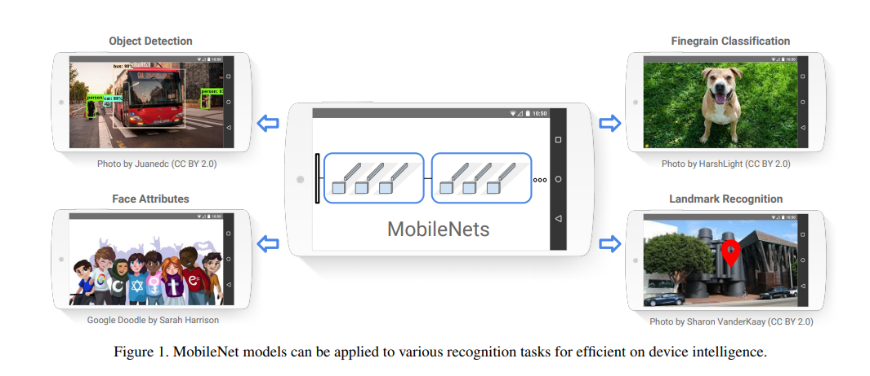
Mobilenets
efficient models for mobile and embedded vision applications
https://arxiv.org/pdf/1704.04861.pdf

Slide 12
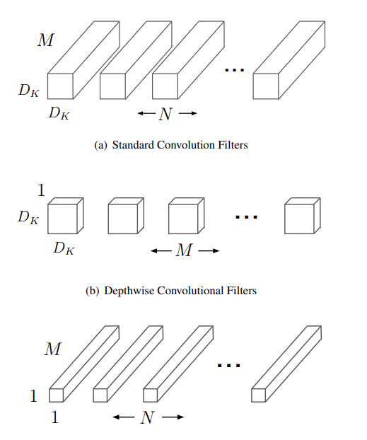
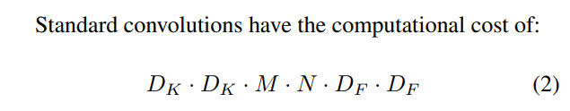
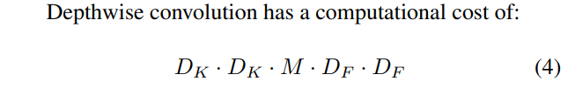
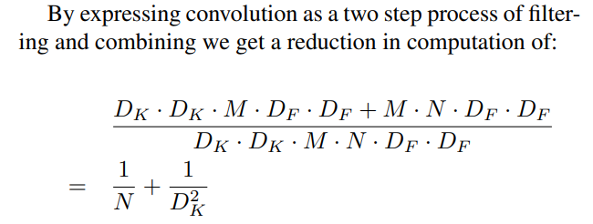
Mobilenets

Slide 13
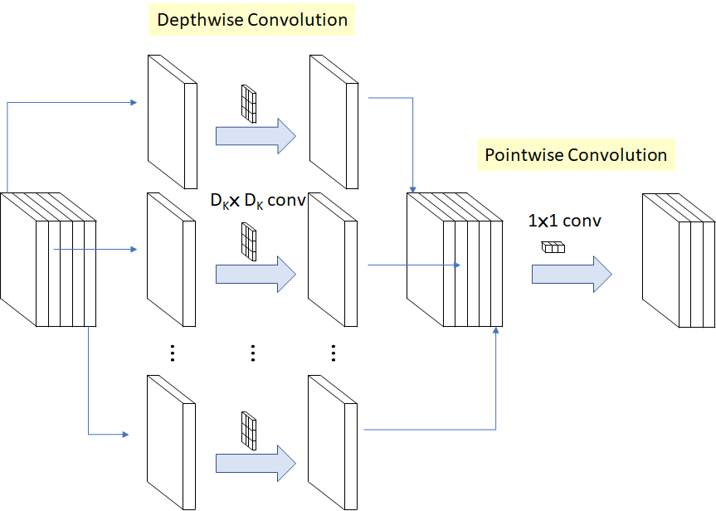
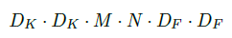
Depth-wise separable convolutions
M: Number of input channels,
N: Number of output channels,
DK: Kernel size
DF: Feature map size
Operation cost:
vs.
Depthwise convolution
Classical convolution

Slide 14
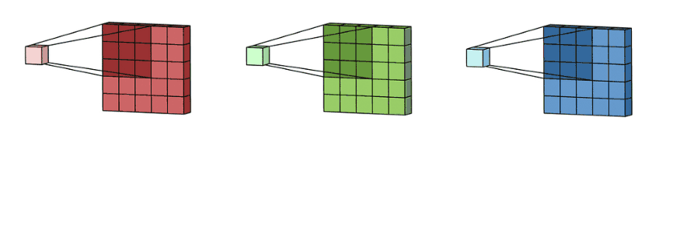
Depth-wise separable convolutions

Slide 15
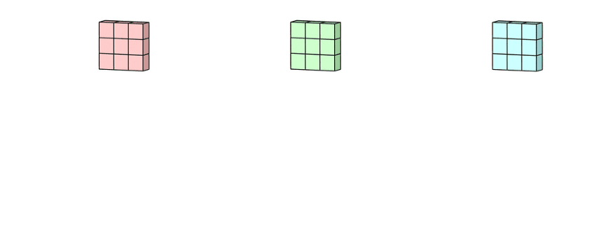
Depth-wise separable convolutions

Slide 16
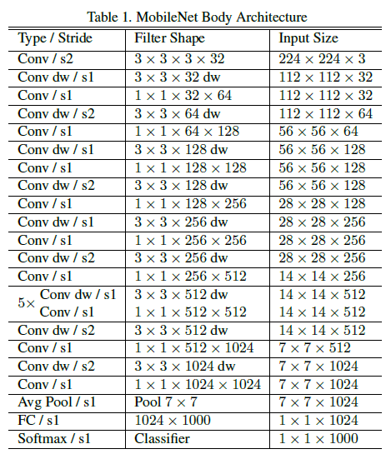
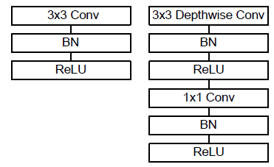
Mobilenets

Slide 17
Other architectures

Slide 18
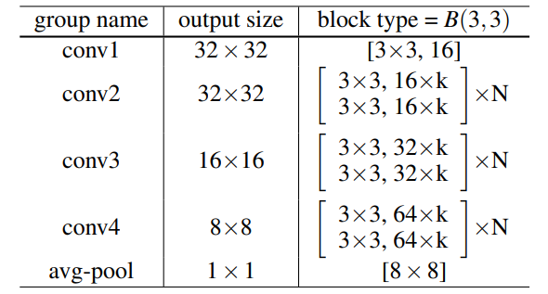
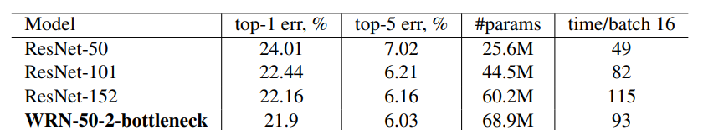
Wide RESNET
Use wider residual blocks (larger number of filters)
50 layer wide resnet is better than 101 layer classical resnet
https://arxiv.org/pdf/1605.07146.pdf

Slide 19
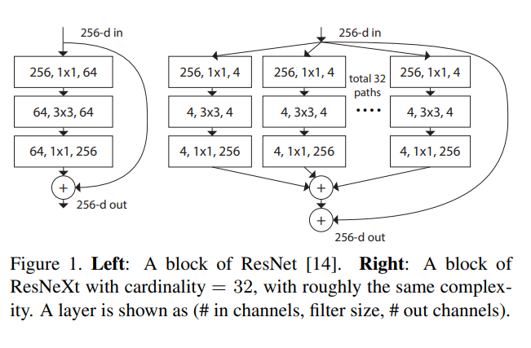
ResNext
Again increase the width of the networks, but this time through parallel branches in a block
https://arxiv.org/pdf/1611.05431.pdf

Slide 20
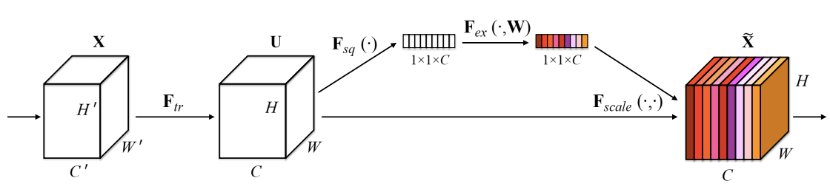
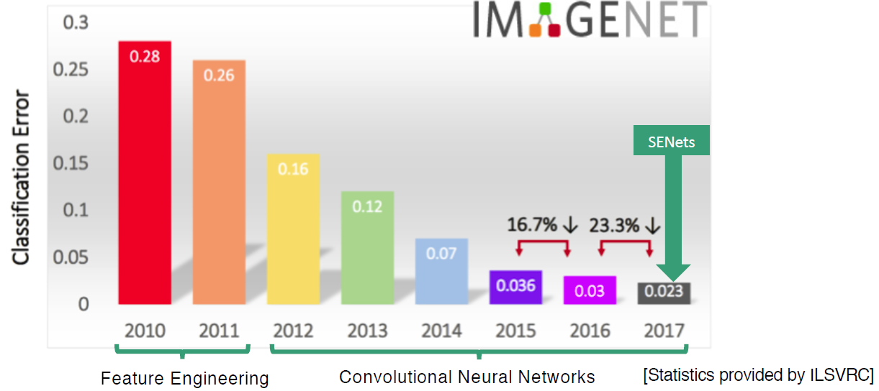
SENet
ImageNet 2017 winner
2.3% top-5 accuracy
Compute weight for each feature map:
Global average pooling
2FC layers
Squeeze-and-Excitation Networks, 2018: https://arxiv.org/pdf/1709.01507.pdf

Slide 21
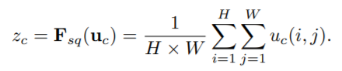
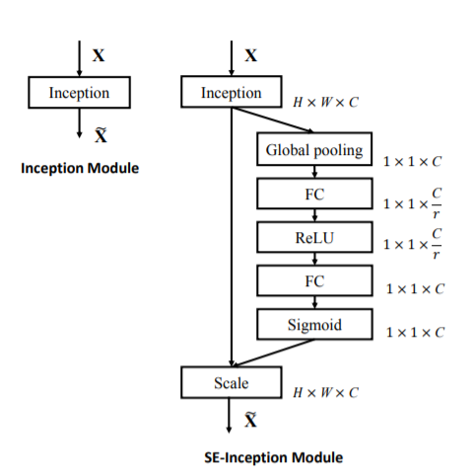
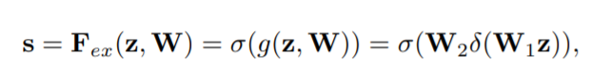
SENet
Squeeze (Global Information Embedding) squeeze global spatial information into a channel descriptor
Excitation (Adaptive Recalibration)
capture channel-wise dependencies
dynamics conditioned on the input

Slide 22
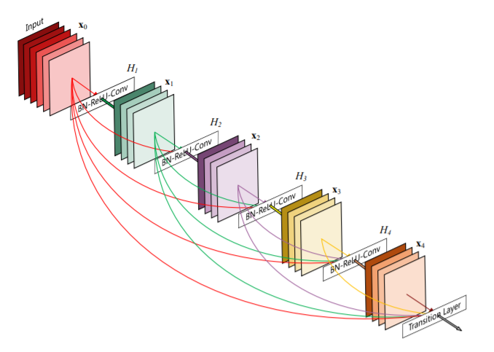
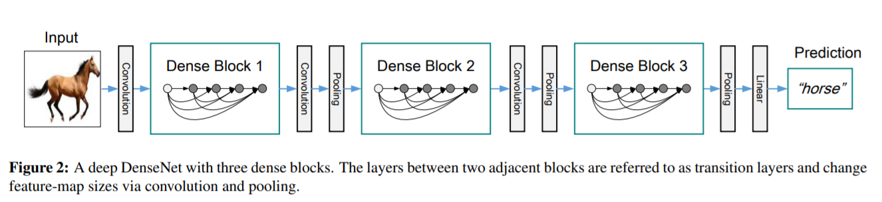
Densely connected networks
Dense block: each layer is connected to every other layer in feed-forward fashion
- strengthens feature propagation,
- encourages feature reuse
- helps with the vanishing gradients problem
Densely Connected Convolutional Networks, 2017

Slide 23
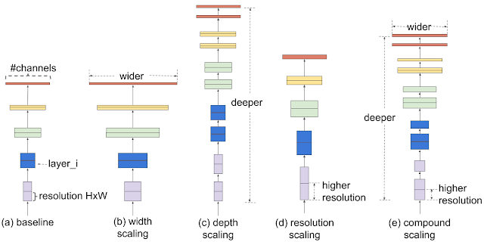
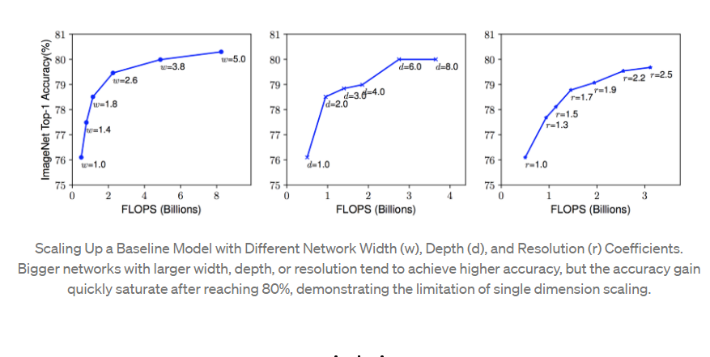
Efficient nets

Slide 24
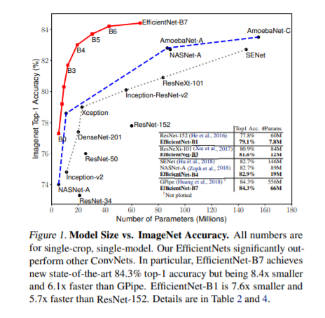
Efficient nets
carefully balancing network depth, width, and resolution can lead to better performance
design a new baseline network and scale it up to obtain a family of models, called EfficientNets

Slide 25
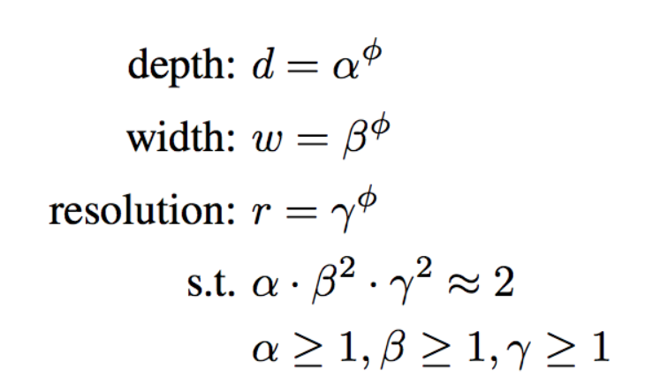
Efficient nets
α · β ² · γ ² ≈ 2 such that for any new φ, the total FLOPS will approximately increase by 2^{φ}
if the input image is bigger, the network needs more layers to increase the receptive field and more channels to capture more fine-grained patterns.
Combined scaling:

Slide 26
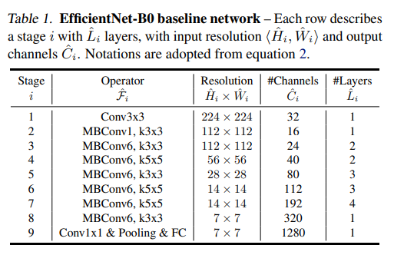
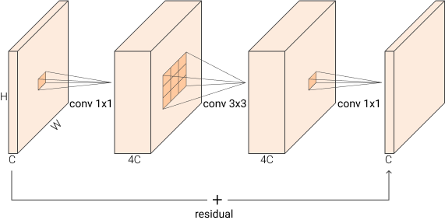
Random grid search to determine α = 1.2, β = 1.1, γ = 1.1
Fix α, β, γ as constants and scale up baseline network with different φ (EfficientNet-B1 to B7)
MBConv

Slide 27
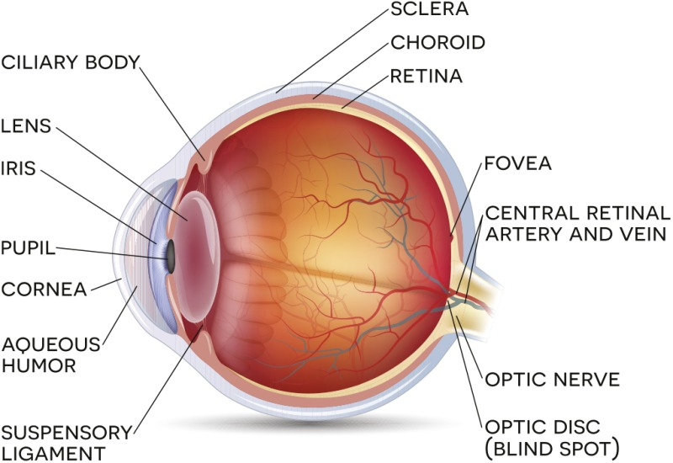
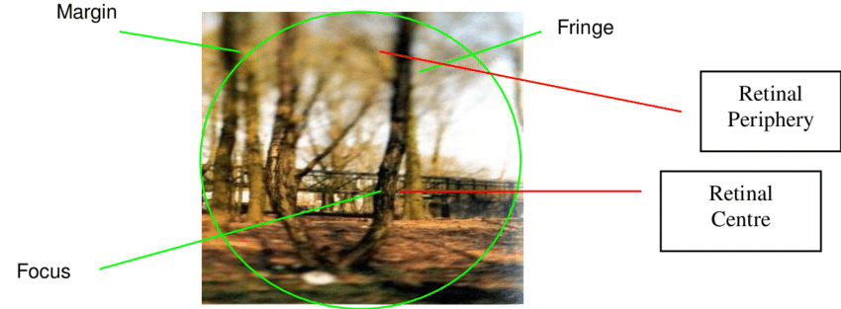
Attention
humans exploit a sequence of partial glimpses and selectively focus on salient parts in order to capture visual structure better
https://www.researchgate.net/figure/Spotlight-model-of-visual-attention-The-attentional-spotlight-and-visual-sensitivity-is_fig5_266283321

Slide 28
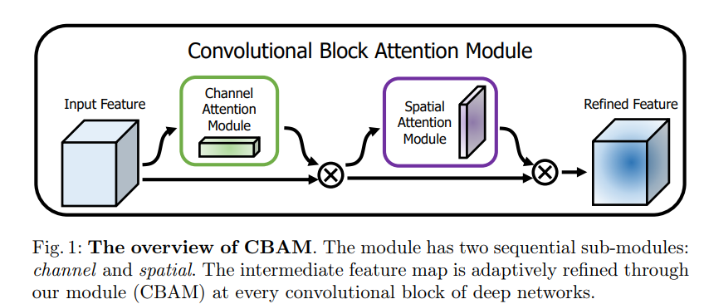
CBAM – Convolutional Block Attention Module
Convolutional Block Attention Module (CBAM):
a simple yet effective attention module for feed-forward convolutional neural networks
https://openaccess.thecvf.com/content_ECCV_2018/papers/Sanghyun_Woo_Convolutional_Block_Attention_ECCV_2018_paper.pdf

Slide 29
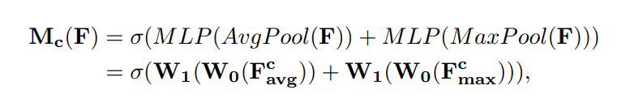
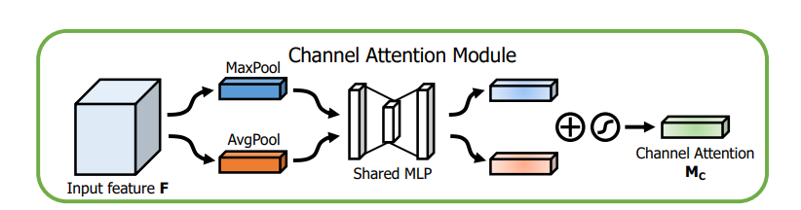
Channel Attention
GAP(Global Average Pooling)
Aggregate spatial information
GMP
Preserve richer context information
Multilayer perceptron (MLP)
Sigmoid activation
Gives the weights for each channel
https://openaccess.thecvf.com/content_ECCV_2018/papers/Sanghyun_Woo_Convolutional_Block_Attention_ECCV_2018_paper.pdf

Slide 30
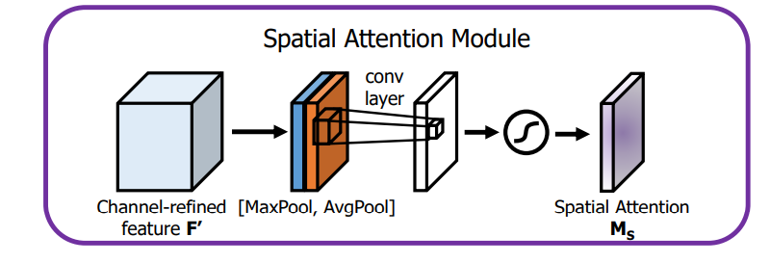
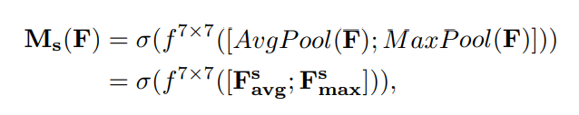
Spatial Attention
Two pooling operations across the channel axis
7x7 Conv
Sigmoid activation
Can be applied element-wise to all the positions in the input feature map
https://openaccess.thecvf.com/content_ECCV_2018/papers/Sanghyun_Woo_Convolutional_Block_Attention_ECCV_2018_paper.pdf

Slide 31
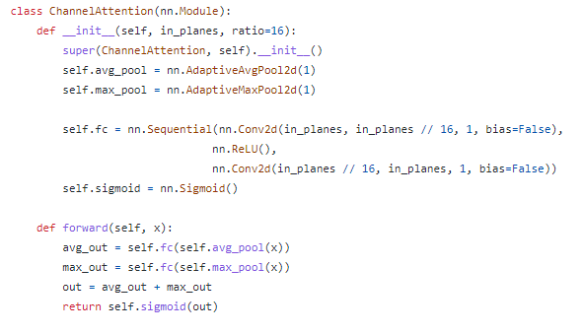
https://pytorch.org/docs/stable/generated/torch.nn.AdaptiveMaxPool2d.html

Slide 32
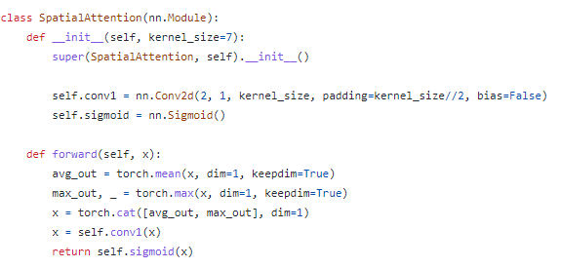

Slide 33
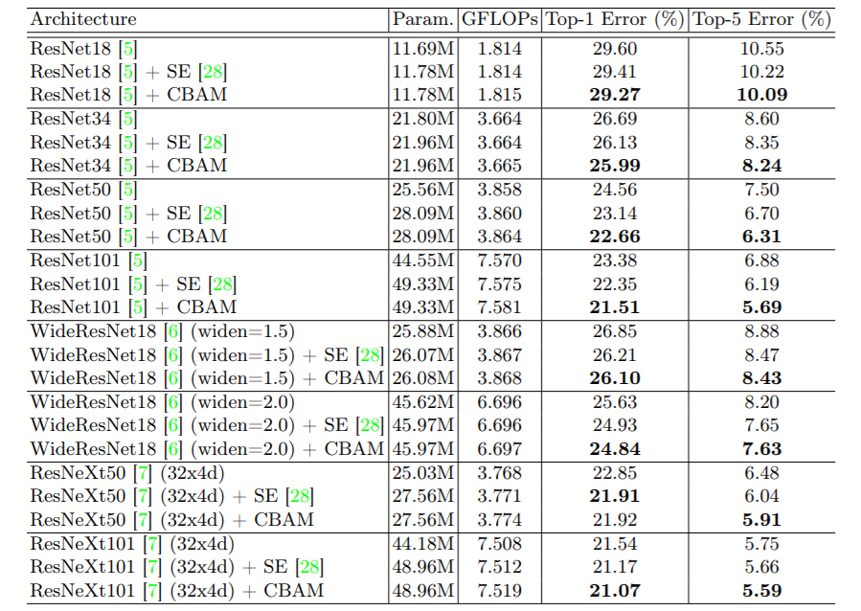
CBAM – Convolutional Block Attention Module
https://openaccess.thecvf.com/content_ECCV_2018/papers/Sanghyun_Woo_Convolutional_Block_Attention_ECCV_2018_paper.pdf

Slide 34
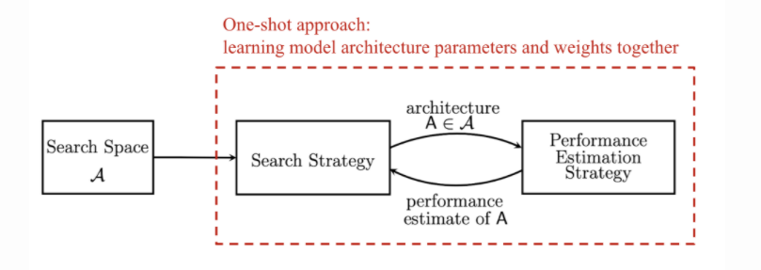
Neural network architectural search
Search space: define a set of operations and how they can be connected.
Search strategy: samples a population of network architecture candidates: child model performance metrics as rewards and optimizes to generate high-performance architecture candidates.
Performance estimation strategy: measure, estimate, or predict the performance of the proposed child models in order to obtain feedback for the search algorithm to learn
https://lilianweng.github.io/lil-log/2020/08/06/neural-architecture-search.html

Slide 35
Summary – CNN architectures
Networks are getting more and more deep
The trend is to not use fully connected layers anymore
Pre-trained models on large datasets are available
ResNet and SENet currently good defaults to use
Convolutional networks design is still a flourishing research area
aspects of network architectures are continuously investigated and improved

Slide 36
Summary – CNN architectures
Alexnet
VGG
Inception
ResNet
SeNet
Wide Resnet
Densely connected nets
Mobile nets
Efficient nets

Slide 37
Multi-task learning
Case study

Slide 38
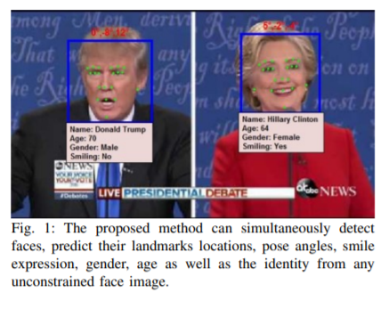
An All-In-One Convolutional Neural Network for Face Analysis (2017)
https://arxiv.org/pdf/1611.00851.pdf
Key ideas that we should take from this paper:
End to end deep learning
Multitask learning
Designing new loss functions

Slide 39
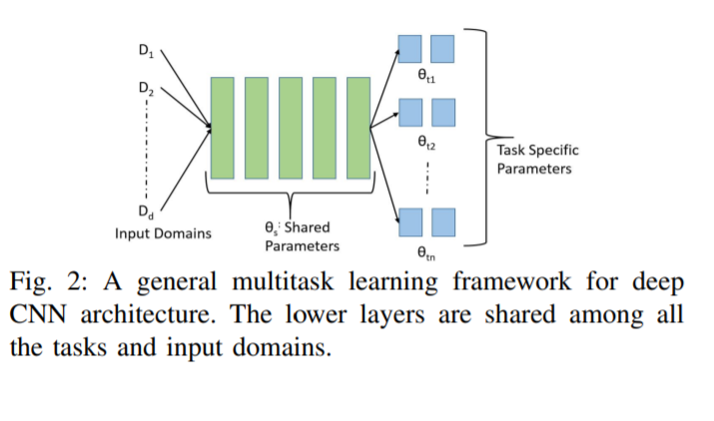
Multi-task learning
When?
Training on a set of tasks that could benefit from having shared lower-level features
Amount of data you have for each task is quite similar
Can train a big enough network to do well on all tasks
https://www.youtube.com/watch?v=UdXfsAr4Gjw

Slide 40
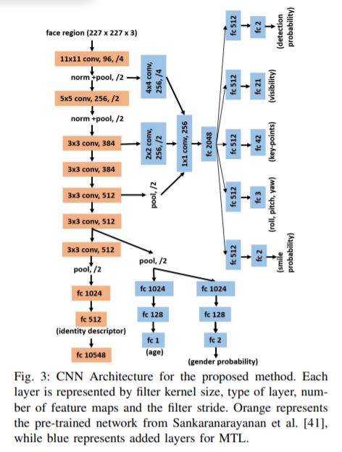
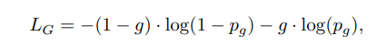
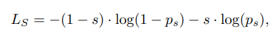
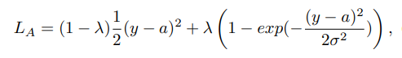
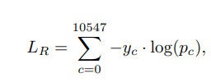
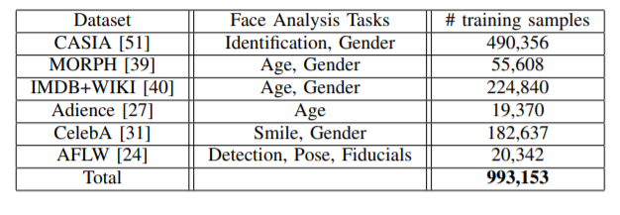
An All-In-One Convolutional Neural Network for Face Analysis (2017)

Slide 41
Face recognition
Case study

Slide 42
Face recognition – case study
Face verification: validating a claimed identity based on the image of a face, and either accepting or rejecting the identity claim (one-to-one matching)
Face recognition: is to identify a person based on the image of a face: the face image has to be compared with all the registered persons (one-to-many matching)
One shot learning

Slide 43
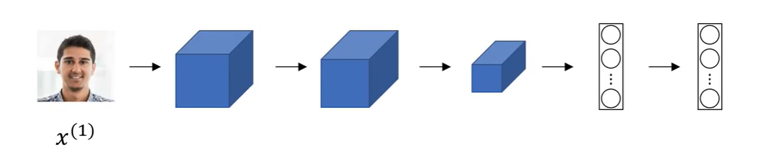
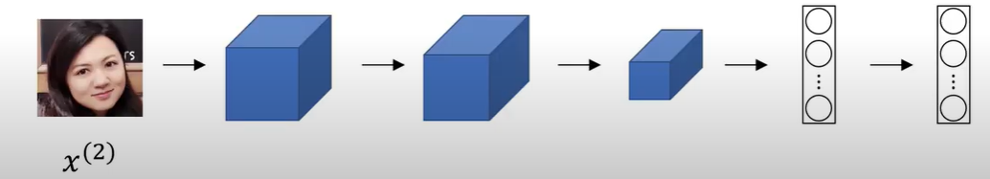
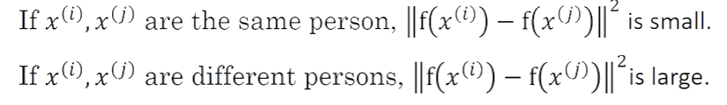
Siamese networks
Two or more inputs are encoded and the output features are compared
Example credit: Andrew Ng, deeplearning.ai, Convolutional Neural Networks

Slide 44


Face verification as a binary classification problem
$$σ(\sum_{k}{ }ω_{i}|f{\left(x^{\left(i\right)}\right)}_{k} −f{\left(x^{\left(j\right)}\right)}_{k} |+b$$
Example credit: Andrew Ng, deeplearning.ai, Convolutional Neural Networks

Slide 45
https://github.com/pytorch/examples/tree/main/siamese_network

Slide 46
Recurrent neural networks
Other resources:
RNNs: http://karpathy.github.io/2015/05/21/rnn-effectiveness/
https://colah.github.io/posts/2015-08-Understanding-LSTMs/
Self attention and transformers (Stanford lecture 2021): https://www.youtube.com/watch?v=ptuGllU5SQQ
Jay Alammar series on Transformers & BERT:
https://jalammar.github.io/illustrated-transformer/
https://jalammar.github.io/visualizing-neural-machine-translation-mechanics-of-seq2seq-models-with-attention/
https://jalammar.github.io/illustrated-bert/

